Slide 1
TECH PIRATES
Team Members:
Jainam Rambhia
M Sai Tanusha
Prateek Mittal

Slide 2
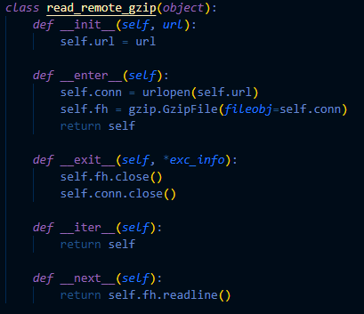
DATA EXTRACTION
Initial work done on data saved locally.
Shifted to url by streaming json data object by object.
Using gzip library, we extracted objects individually.

Slide 3
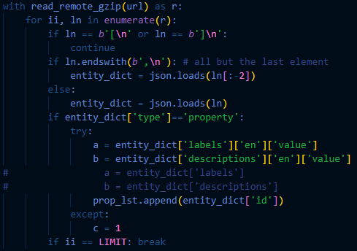
DATA PROCESSING AND LOADING
Since the labels and descriptions were in multiple languages, we simplifies the data by removing all objects with no labels and description in english.
This resulted in loss of 16 property objects out of a total of 300.
Cleaned the item objects to contain claims to only those property objects which were filtered above.

Slide 4
CREATING GRAPH
Once items and properties were created. Edge Collection was formed.
Keys were the id of item and property.
Specified the from and to collections in edge.
Once edge Collection Created, Edge Definition is formed which then helps to create the Graph.

Slide 5
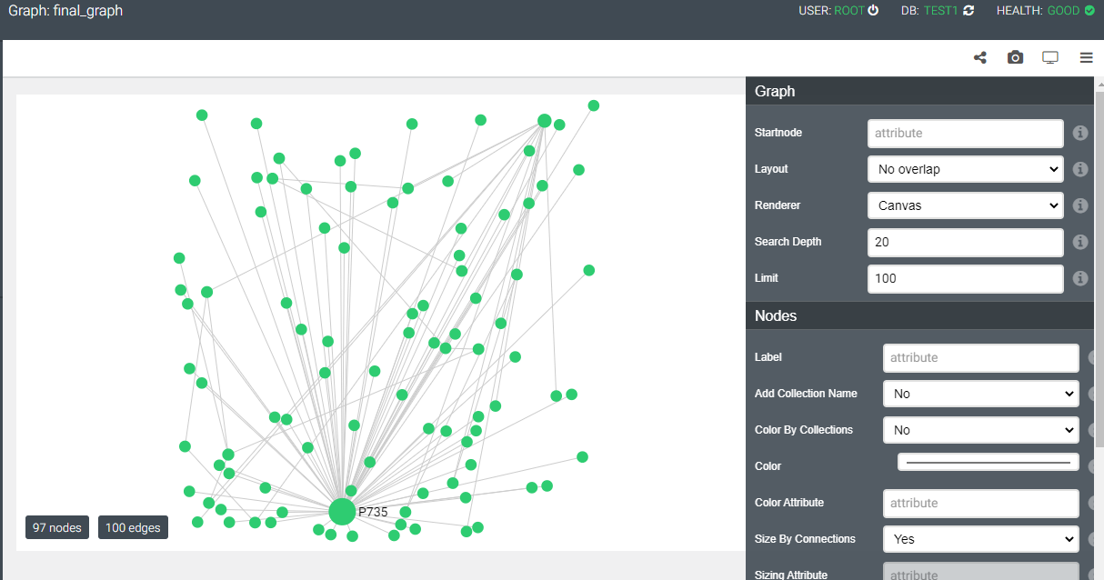

Slide 6
THANK YOU!

